Slide 1
VashaShikkha Class Diagrams
Group 4
Members-
1705007, 1705013, 1705018, 1705021, 1705023, 1705025

Slide 2
Modules
Login
Registration
Entry Test
Section
Level based test
Retry Wrong Attempts
Leaderboard
Dictionary
Flashcard
Notification
Admin

Slide 3
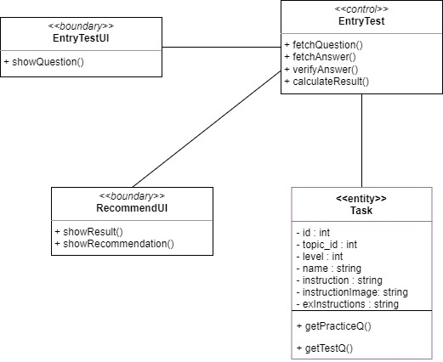
Entry test

Slide 4
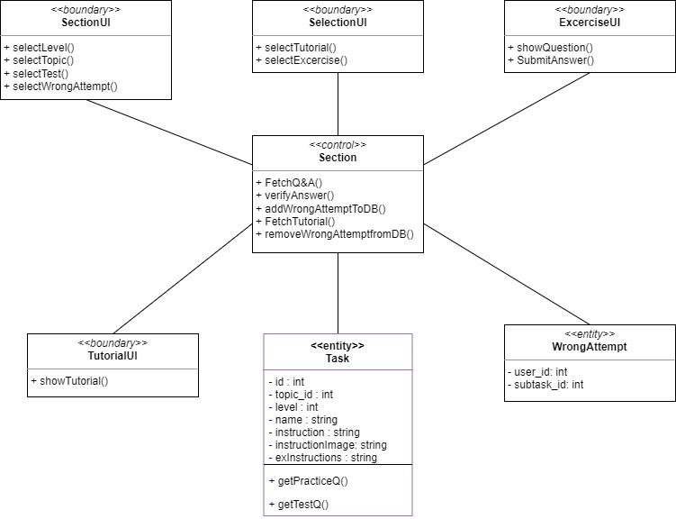
Section

Slide 5
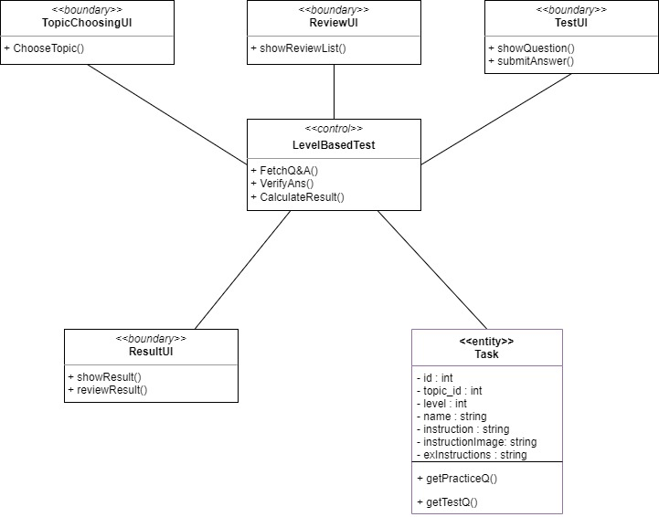
Level based test

Slide 6
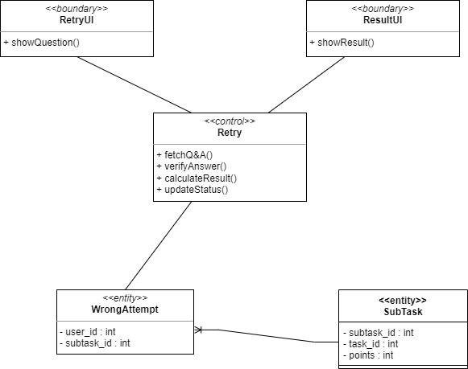
Retry wrong attempts

Slide 7
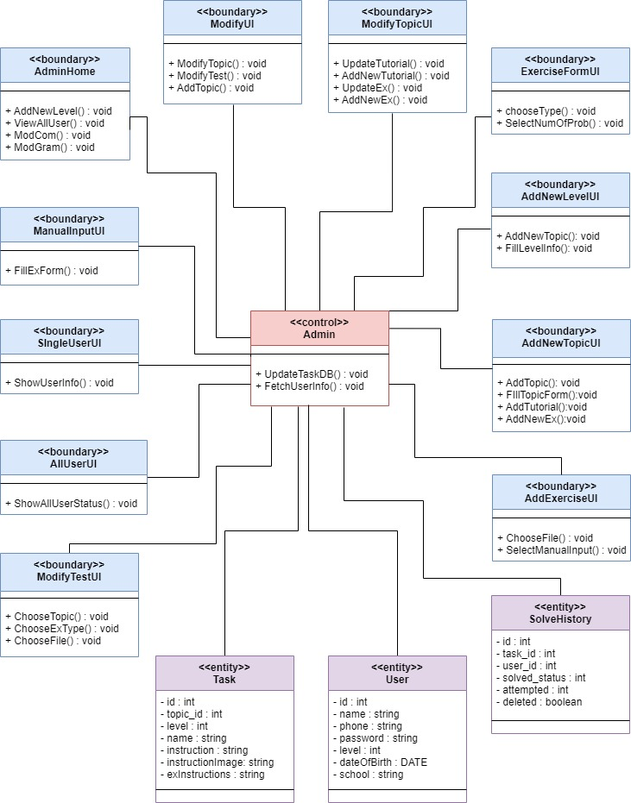
Admin

Slide 8
Thank you

